Slide 1
Machine Learning Midterm
Talia Kouncar

Slide 2
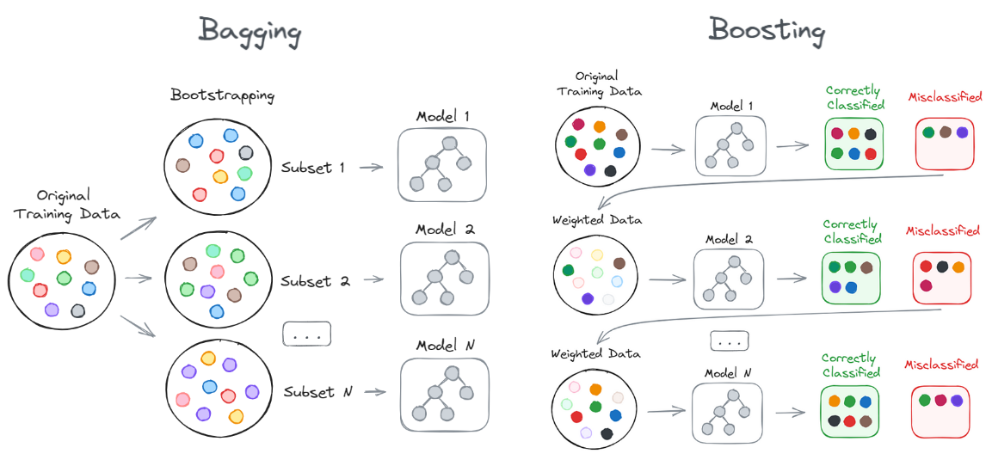
Introduction to ensemble learning
Topic: Ensemble Bagging and Boosting: A Deep Dive into Tree-Based Models.
The Problem: A single decision tree often struggles with "overfitting" (memorizing data but failing on new data) or "underfitting" (failing to capture the data's complexity).
The Ensemble Solution: A machine learning approach that combines multiple individual models to solve a single predictive problem, resulting in drastically improved accuracy and stability.

Slide 3
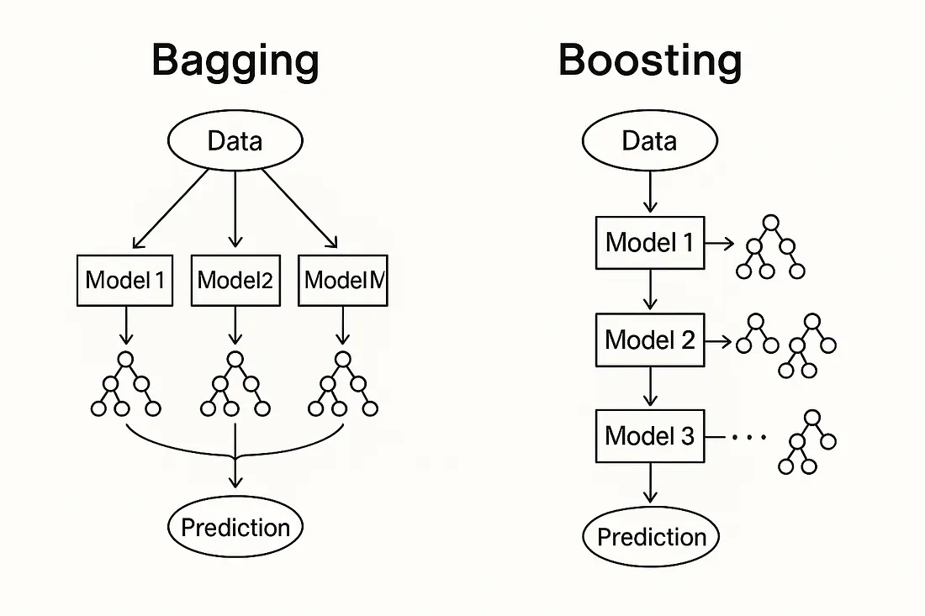
Purpose and architecture- bagging
An Analogy: Think of bagging as a group of people working on the same problem independently and then combining their results to get a better overall answer.
How it Works:
Parallel Training: Multiple models are trained in parallel, each on a different random subset of the original data (created by sampling with replacement, known as "bootstrapping").
Independent Models: The models are entirely independent of each other.
Combining Results: The final prediction is determined by taking the average (for regression) or using a majority vote (for classification).
Main Goal: To reduce variance and prevent overfitting.

Slide 4
Purpose and architecture- Boosting
An Analogy: Think of boosting as a team where members learn sequentially, and each new member focuses specifically on the mistakes made by the previous ones to improve the team's performance.
How it Works:
Sequential Training: Models are trained in a sequence, rather than at the same time.
Focusing on Errors: Each new model pays more attention to the data points that were misclassified by previous models by assigning higher weights to those difficult data points.
Combining Results: The final prediction is a weighted combination of all models, where better-performing models have more influence.
Main Goal: To reduce bias, handle underfitting, and convert "weak" learners into a "strong" learner.

Slide 5
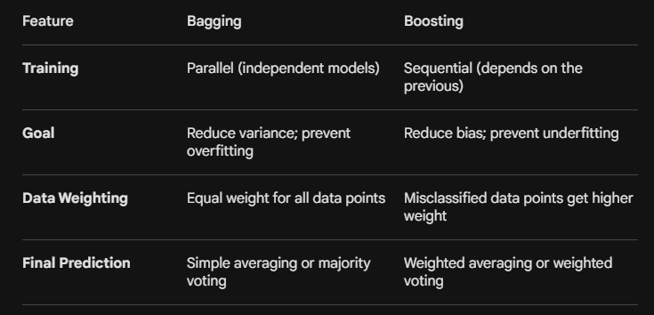
Architecture comparison

Slide 6

Real world applications
Industrial Digitalization & AI: Highly effective for fleet analytics and heavy equipment monitoring. For example, forecasting commercial truck or vehicle component failures by analyzing continuous sensor data like engine vibration and fluid pressure.
Model Performance Evaluation: Ensemble models easily generate "Feature Importance" metrics, identifying which variables had the most mathematical impact on the predictions.
Financial Services: Used heavily for real-time credit scoring and credit card fraud detection due to their ability to quickly classify complex, non-linear data patterns.

Slide 7
Step by step setup/install
Prerequisites & Dependencies: * Python 3.8 or newer installed on your machine.
Core libraries: scikit-learn (for Bagging/Random Forest), xgboost (for Boosting), pandas (for data handling), and numpy (for numerical operations).
Step-by-Step Installation:
Verify Python: Open your terminal or command prompt and type python --version to ensure Python is active.
Create a Virtual Environment (Recommended): Isolate your project by running python -m venv ensemble_env and activating it.
Install Core Packages: Run the exact command: pip install scikit-learn xgboost pandas numpy.
Verify Installation: Open a Python shell and type import sklearn and import xgboost. If no errors are returned, the setup is complete.
Potential Challenges to Watch Out For:
C++ Compiler Requirements: Depending on your operating system, XGBoost may require a C++ compiler (like GCC or MSVC) to build correctly from source.
Library Version Conflicts: Installing these tools globally can sometimes cause conflicts with older versions of numpy or scikit-learn already on your system, which is why a virtual environment is highly recommended.
Resource Constraints: If working with very large datasets, installing the GPU-accelerated version of XGBoost might be necessary to avoid long training times.

Slide 8
Ml pipeline integration
Phase 1: Data Preprocessing
Advantage: Tree-based ensemble models do not require feature scaling or normalization (unlike neural networks).
Requirements: You still must handle missing data (imputation) and convert all text-based categorical data into numerical values using techniques like One-Hot Encoding.
Phase 2: Training & Hyperparameter Tuning
The Process: The model is fed the preprocessed data to learn patterns.
Tuning: This phase heavily utilizes tools like GridSearchCV to find the optimal settings, such as n_estimators (number of trees) and max_depth (how large each tree can grow), ensuring the model balances bias and variance.
Phase 3: Model Evaluation
Validation: Using k-fold cross-validation to test the model on multiple different splits of the data.
Metrics: Depending on the use case, the model is evaluated using specific metrics. For predicting vehicle maintenance failures, you would track Accuracy, Precision, Recall, and the ROC-AUC curve to minimize false positives.
Phase 4: Deployment
Exporting: The fully trained ensemble model is saved as a serialized file using libraries like joblib or pickle.
Production: The saved model is integrated into a live software environment (like a Flask or FastAPI application) where it can ingest live streams of data—such as live vehicle sensor feeds—and return real-time predictions.

Slide 9
MiniWorkshop
Mini Workshop Link: https://colab.research.google.com/drive/1ddRfA-r5EVBwEbLGNnkTOOtjQS827EYc?usp=sharing
To demonstrate this tool's functionality, we are using a Vehicle Predictive Maintenance scenario. Our goal is to predict if a commercial vehicle engine is going to break down before it actually happens. To do this, we are feeding our models synthetic telemetry data from three sensors: Engine Temperature, Vibration, and Fluid Pressure.
We rigged the dataset so that a breakdown occurs when temperature and vibration spike simultaneously. This is a perfect use case for Bagging and Boosting because these models excel at cutting through noisy sensor data, like irrelevant pressure fluctuations, to pinpoint the exact mathematical patterns that lead to a breakdown.

